Slide 1
Single-cell RNA-sequencing analysis workshop
31 October 2023

Slide 2
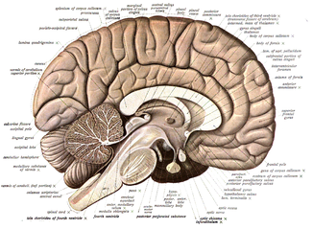
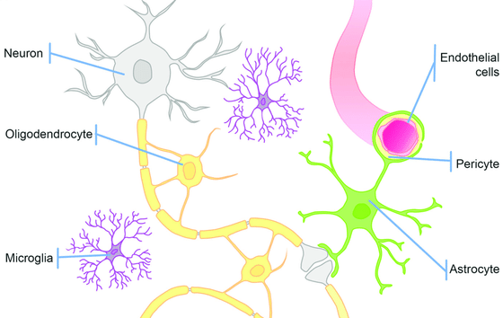
The brain is an extremely heterogeneous structure
Carpanini, Torvell, & Morgan (2019)

Slide 3
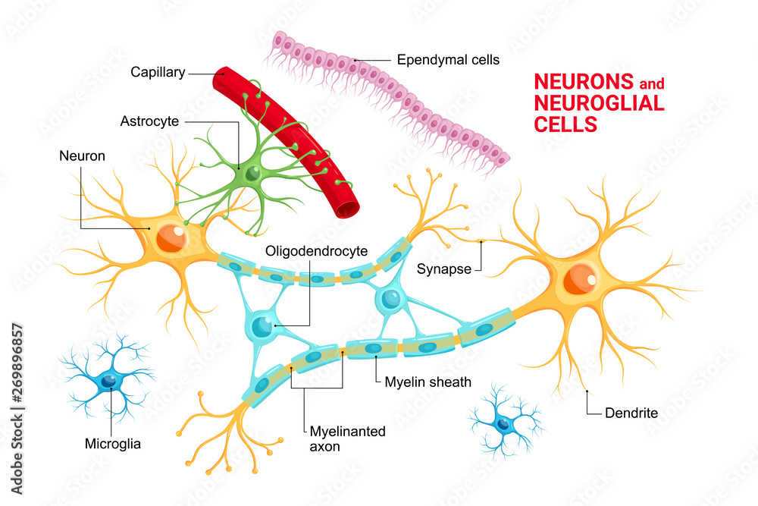
Major cell classes in the brain
Neurons
Major electrically active cells, responsible for signal processing and propagation in the brain
Excitatory neurons
Generally activate other neurons, can have long range projections to different brain regions
Inhibitory neurons
Generally repress activity in other neurons, tend to be locally projecting
Astrocytes
Involved in blood-brain barrier maintenance, neurotransmitter clean-up, neuronal health maintenance
Microglia
Resident innate immune cells in the brain, responsible for surveillance, synaptic pruning, and brain health
Ependymal cells
Line the brain ventricles, generate cerebrospinal fluid
Glia
Historically thought of as “support” cells, but have a wide array of functions related to overall brain health
Oligodendrocytes
Myelinate neuronal axons to allow for more efficient signal processing
Vascular cells
Involved in blood-brain barrier maintenance, ensure stability of vasculature in the brain

Slide 4
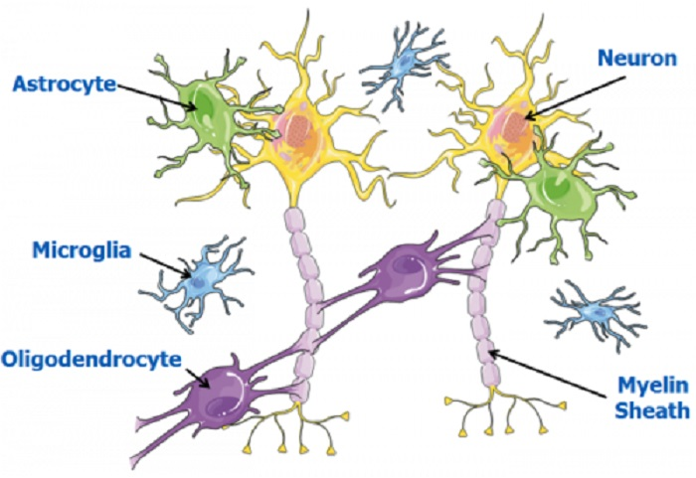
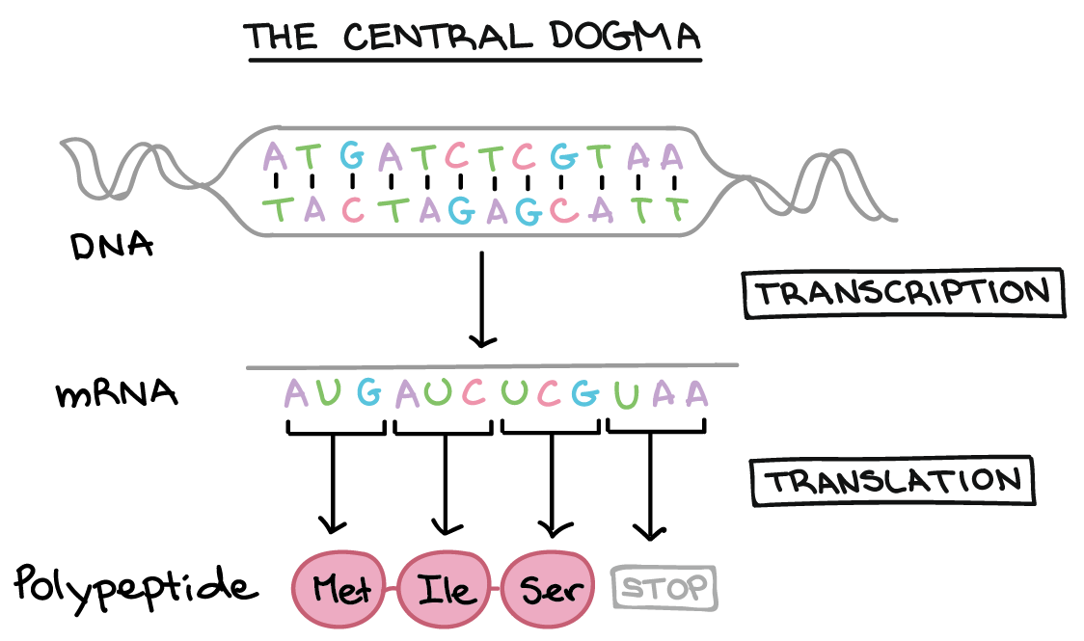
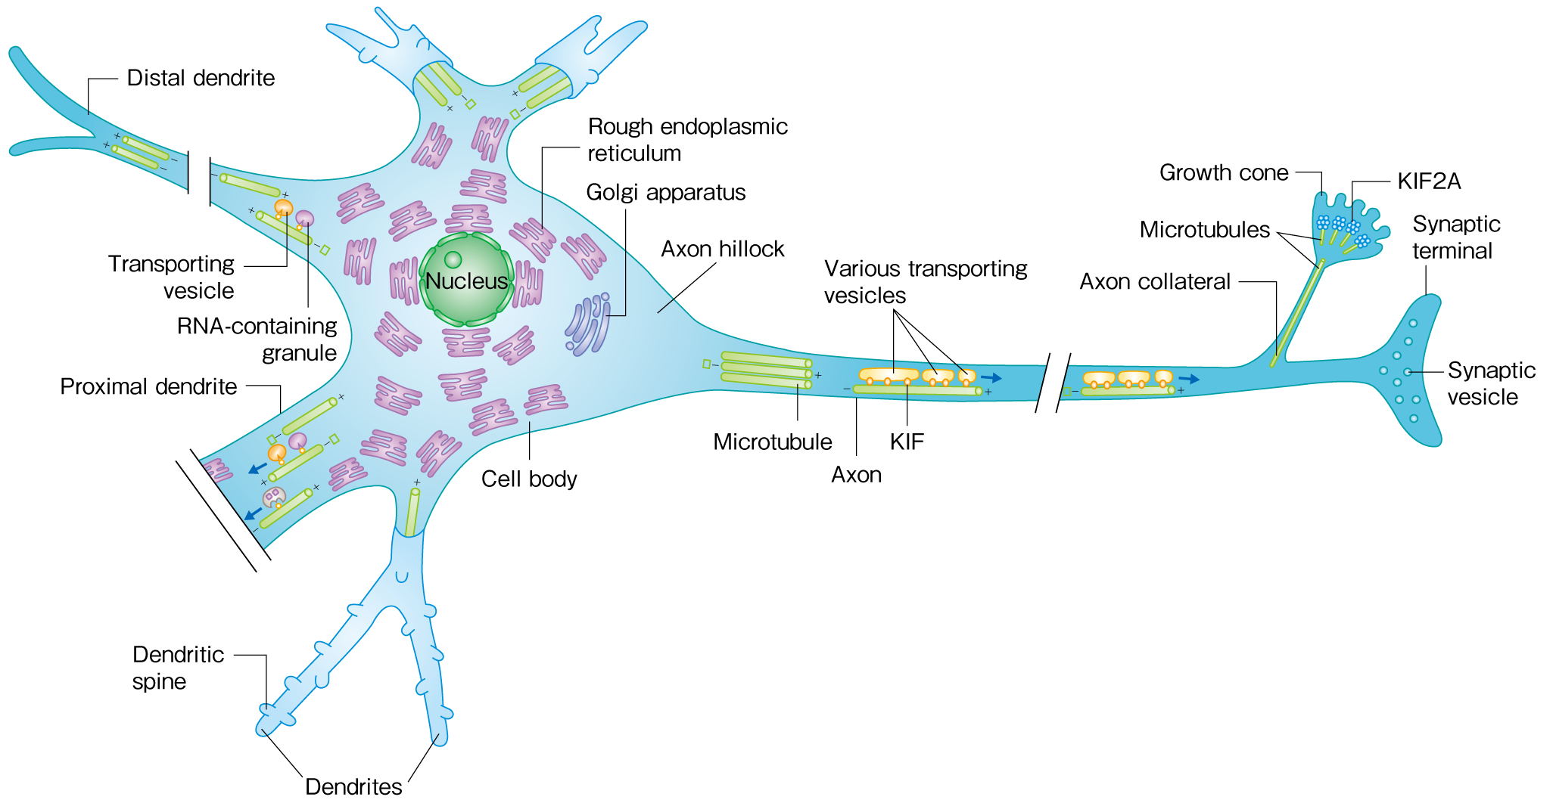
Molecular profiling of brain tissue
Hirokawa, 2018
Objective: Quantify mRNA (& protein) levels in brain tissue from individuals with and without disease

Slide 5
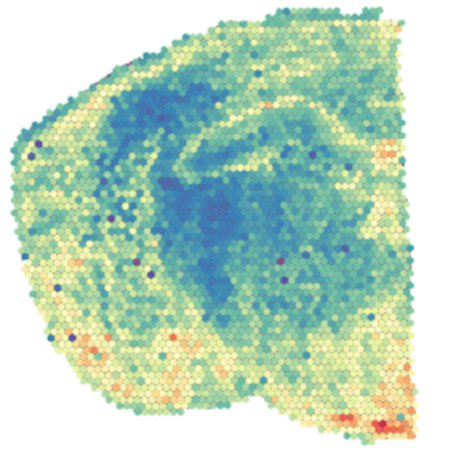
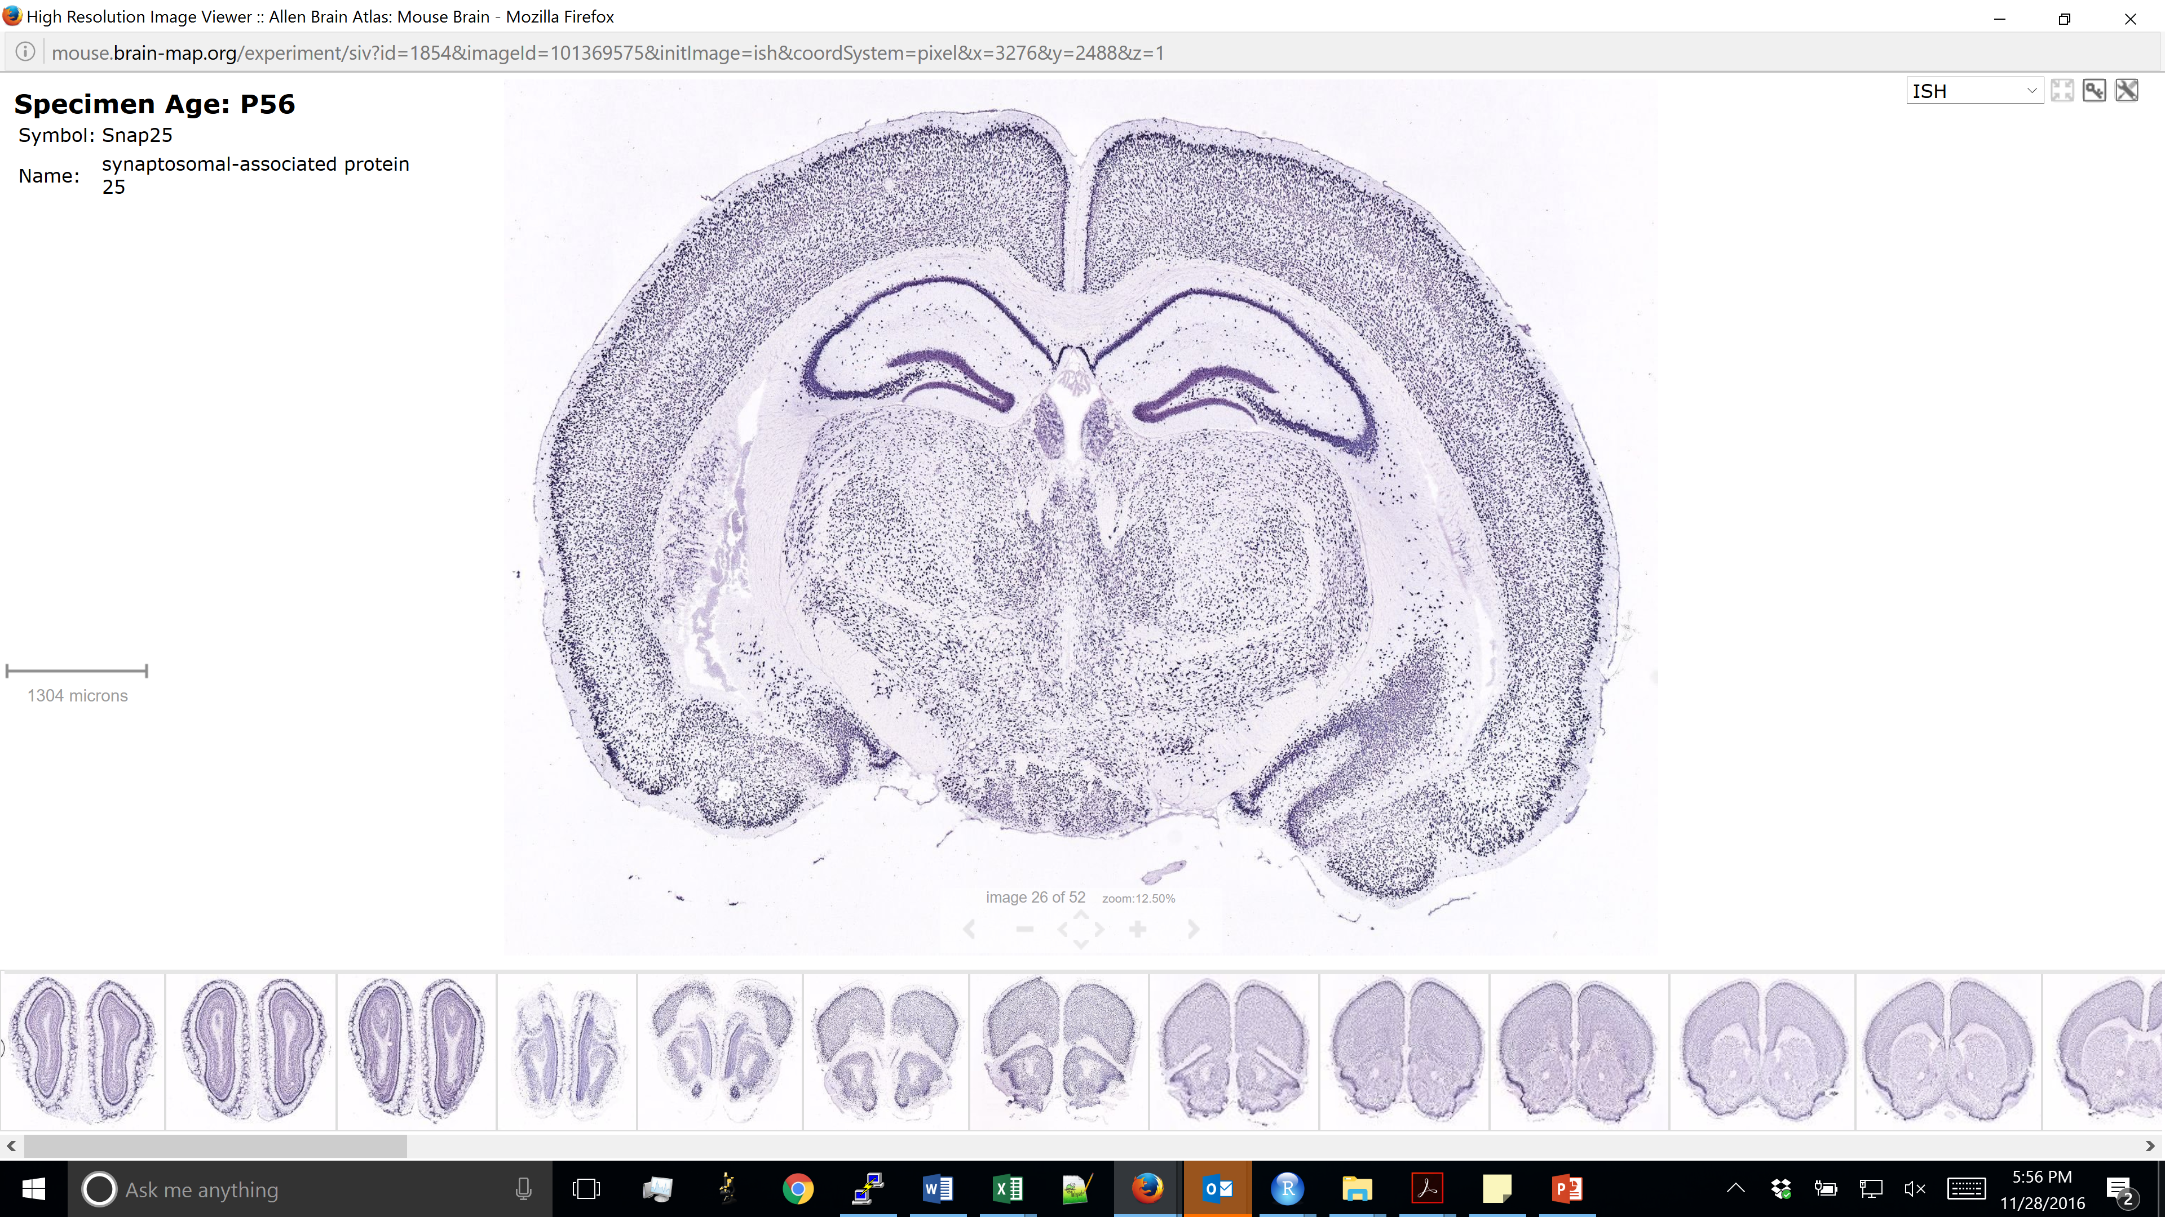
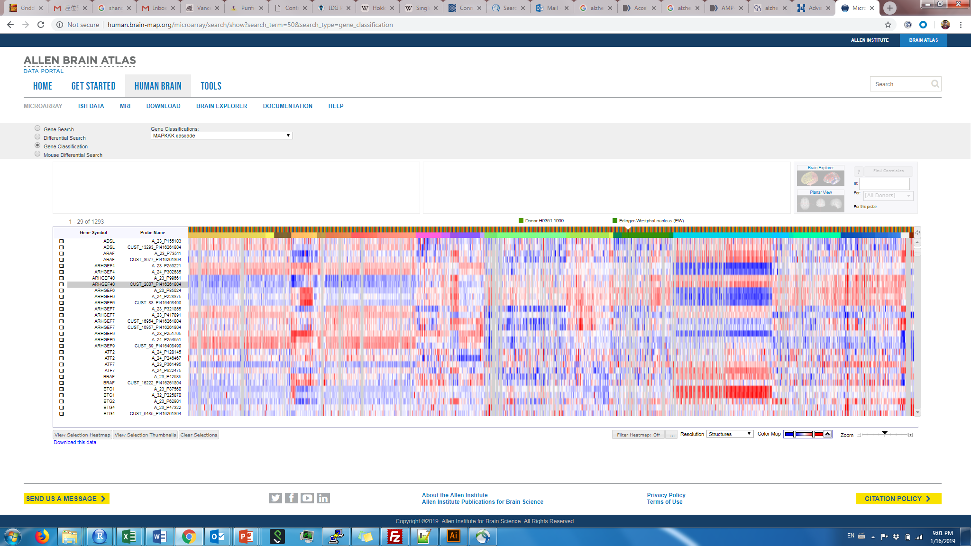
Molecular profiling methods
Method | ISH/IHC | RNA-sequencing
# of genes/proteins at once | ~1 – 5 (~500 with advanced methods) | ~10,000 – 20,000
Single-cell resolution | Yes | No
Spatial information | Yes | No
“Unbiased” (no pre-selection) | No | Yes
Single-cell RNA-seq
~1,000 – 10,000
Yes
No
Yes
Spatial transcriptomics
~1,000 – 10,000
No
Yes
Yes

Slide 6
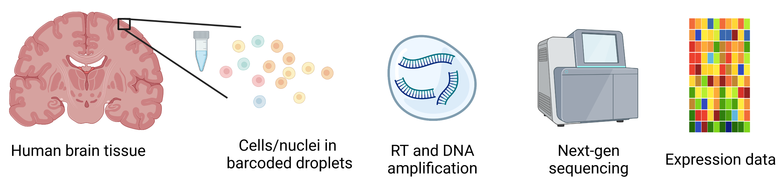
Bulk and single-cell/nucleus RNA-seq
Bulk RNA-seq | Single-cell/nucleus RNA-seq
More robust | Easier to identify cell type-specific signatures
Lower cost | Higher resolution
Can capture all RNA | Restricted to somatic or nuclear RNA
Tissue homogenization (bulk)

Slide 7
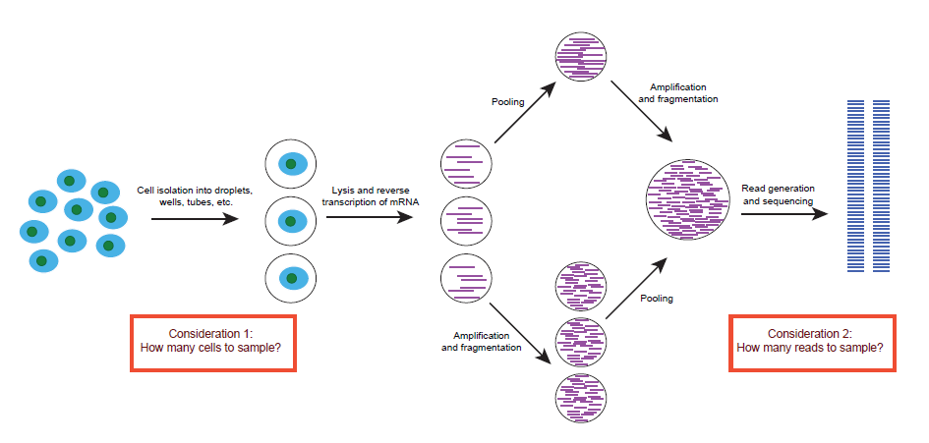
Single-cell RNA-seq workflow
Barcoded methods (e.g. 10x Genomics Chromium, Drop-Seq, InDrop, CEL-Seq, MARS)
Higher throughput
Only get 5’ or 3’ end of the transcript
Can account for amplification artifacts
Non-barcoded methods (e.g. SMART-Seq2)
Can obtain full-length transcripts
Higher sensitivity
Lower throughput

Slide 8
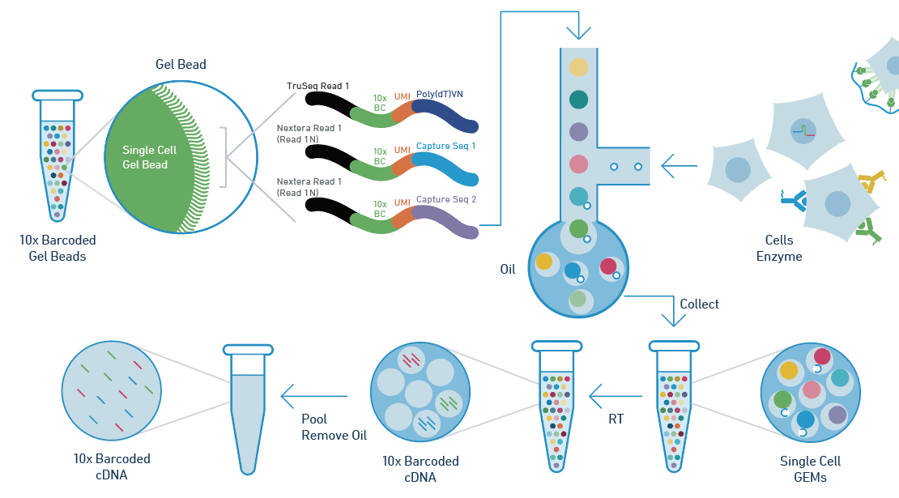
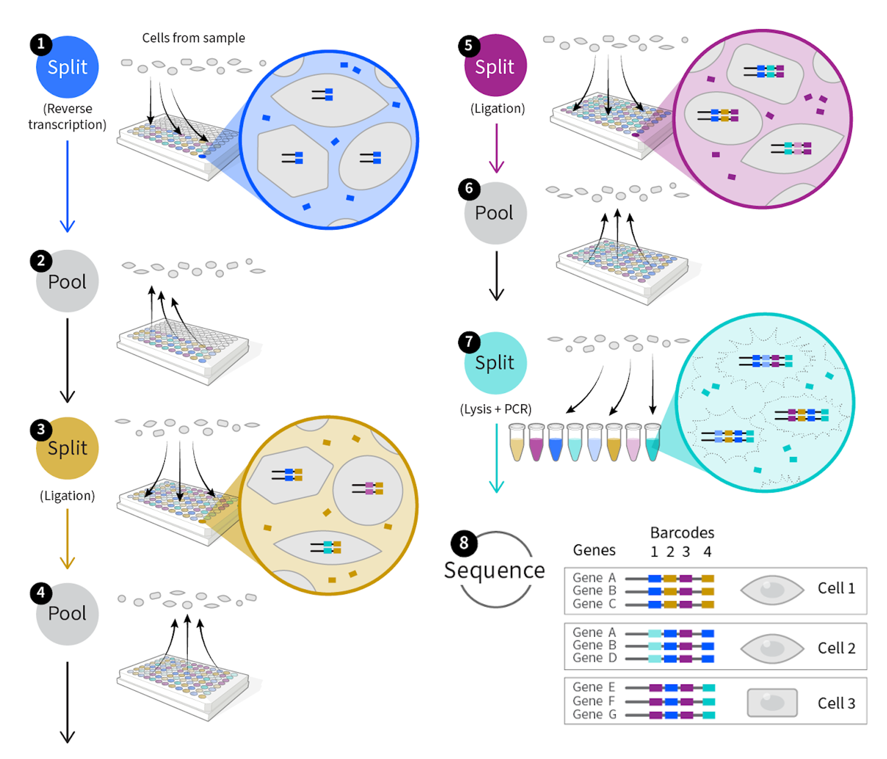
Single-cell RNA-seq barcoding
Droplet-based (barcodes are pre-generated)
Split-pooling (barcodes are combinatorially generated)
10x Genomics Chromium workflow, Drop-seq, InDrop
SPLIT-Seq, Parse Biosciences workflow

Slide 9
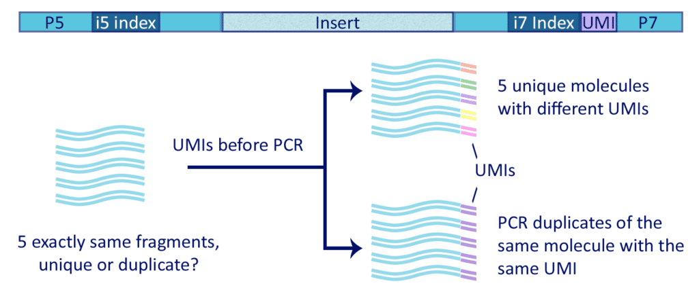
Unique Molecular Identifiers – counting transcripts
Kavaklioglu 2019

Slide 10

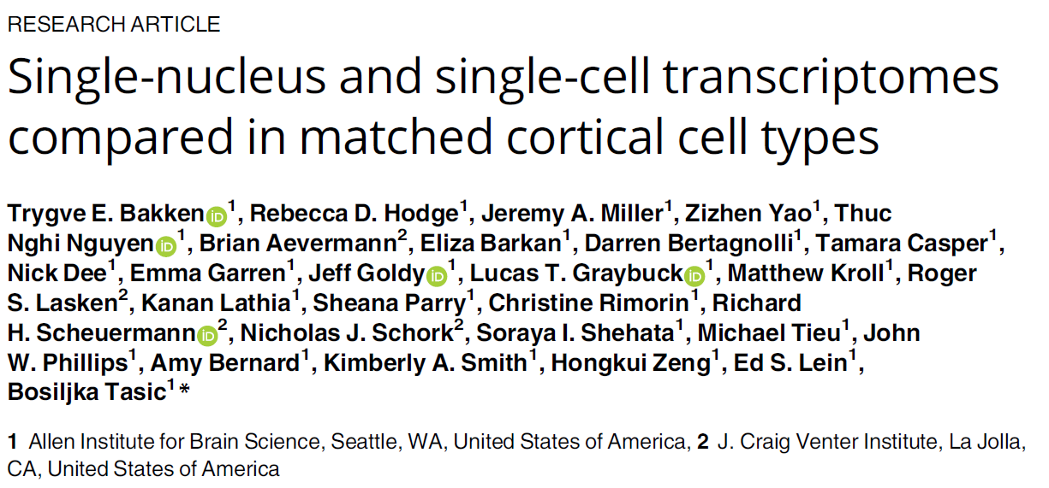
Single-cell vs. single-nucleus RNA-seq
Single-cell RNA-seq | Single-nucleus RNA-seq
Higher gene detection | Lower gene detection
Captures cytoplasmic transcripts | No cytoplasmic transcripts
Developed (so far) only for fresh human tissue | Feasible on frozen adult human brain tissue
So far, robust data only for microglia and astrocytes (with one exception in 2015) | Can obtain all canonical brain cell types
Strong survivability bias | Less survivability bias

Slide 11
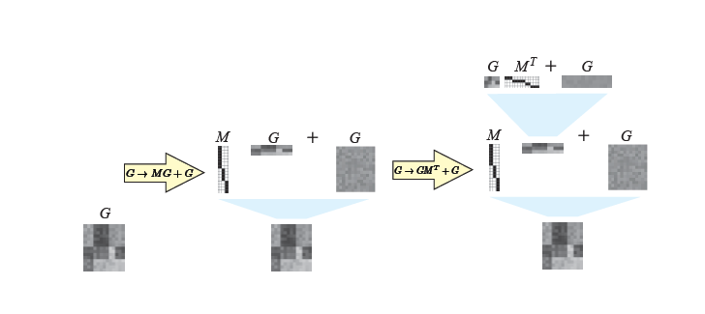
Analyzing single-cell RNA-seq data
Most single-cell RNA-seq analysis methods try to solve a clustering (matrix reordering) problem
“Cell type” 1
“Cell type” 2
Grosse et al. 2012
“Cell type” 3
Menon 2017

Slide 12
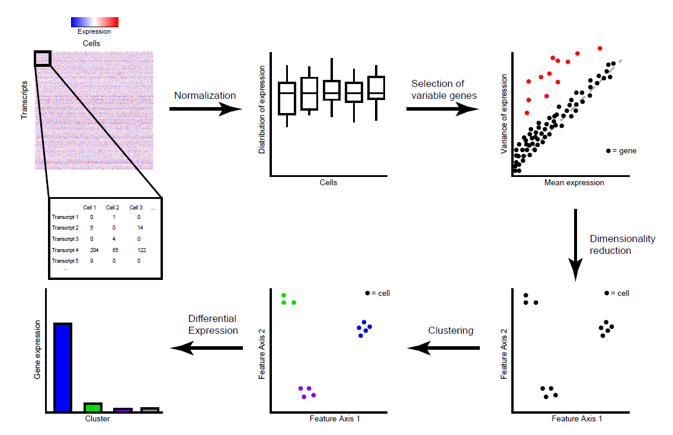
Standard analytical (clustering) workflow
Fundamental assumption:
Cell types are distinguished by coordinated differences in expression across multiple genes

Slide 13
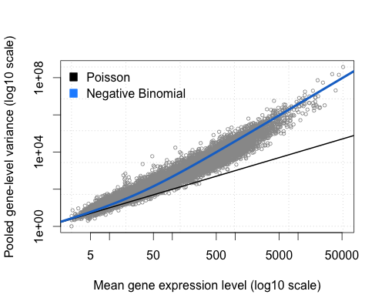
High-variance gene selection
Select genes based on dispersion (variance/mean) – keep genes that have high variance based on their mean
Why is this step important?

Slide 14
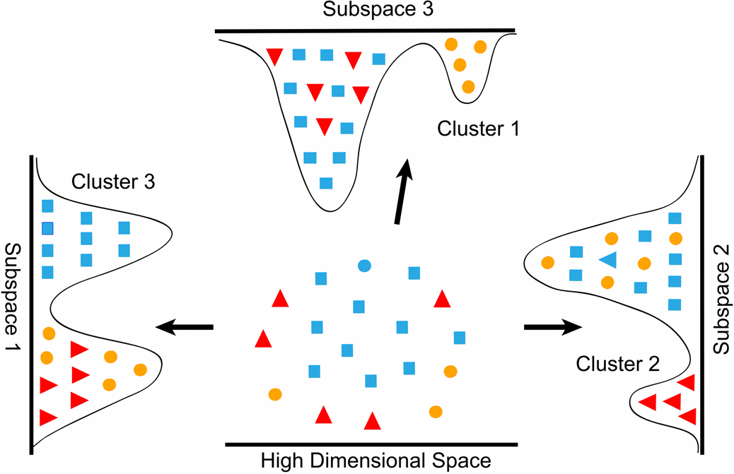
Dimensionality reduction
“Cell type” 1
“Cell type” 2
“Cell type” 3

Slide 15
Dimensionality reduction for visualization versus clustering
Dimensionality reduction for clustering
Often require >>2 dimensions
Distance metric needs to preserve local and global similarity/differences
PCA, Gene module analysis, autoencoder-based approaches
Dimensionality reduction for visualization
Need to work in 2 (or 3) dimensions
Distance metrics are often highly nonlinear, and non-interpretable over large differences
t-SNE, UMAP
Different purposes

Slide 16
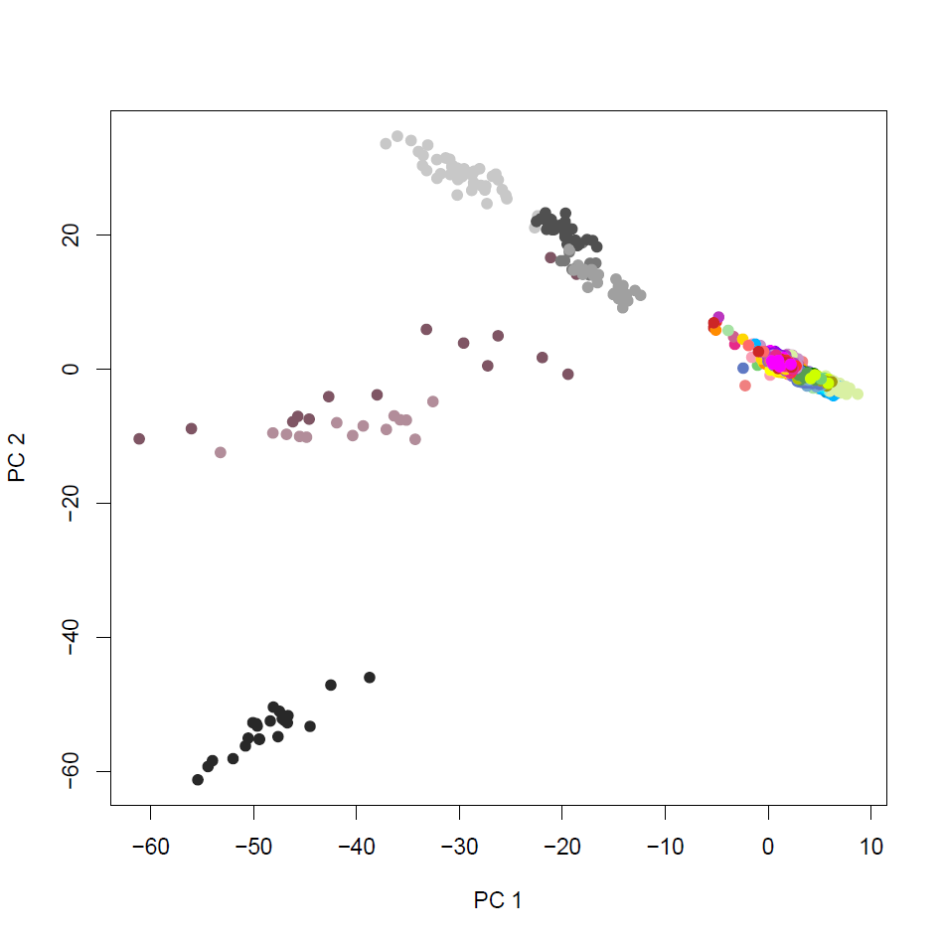
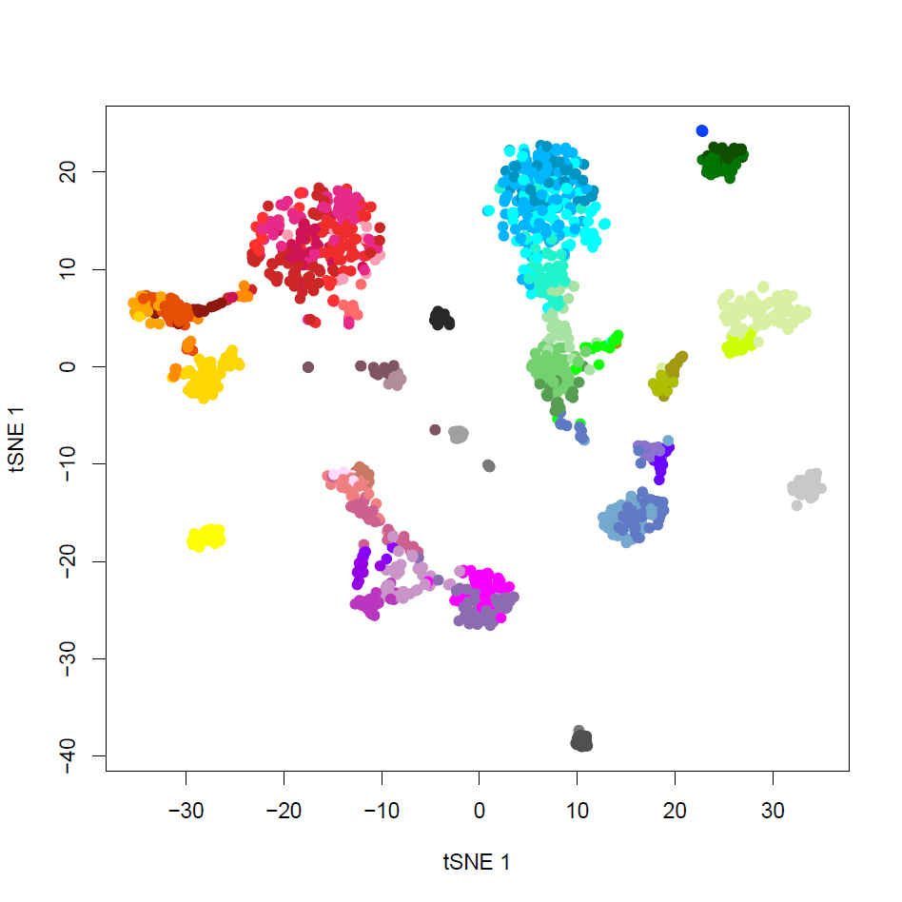
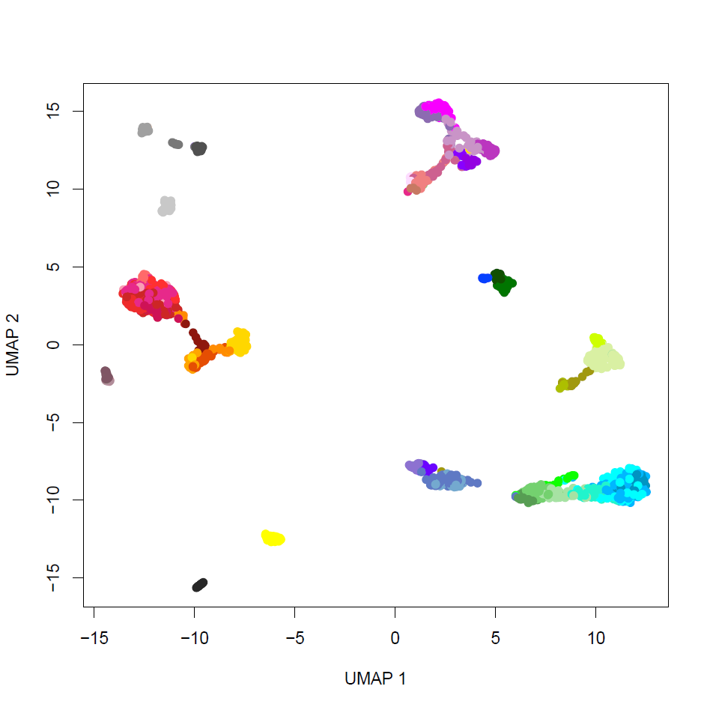
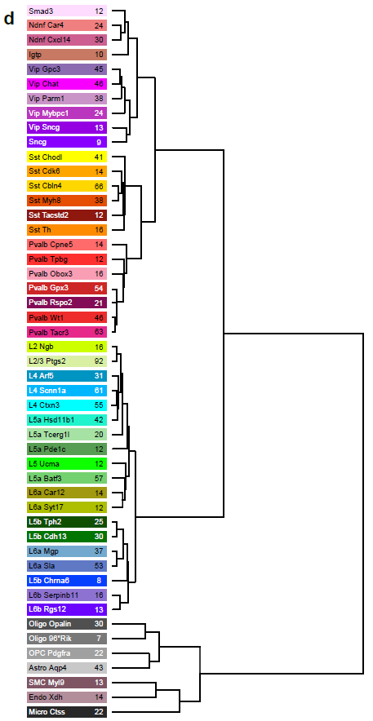



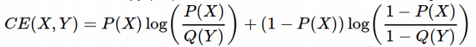
Dimensionality reduction methods
PCA with 2 PCs
tSNE
UMAP
Glutamatergic (Excitatory) Neurons
Nonlinear, preserves local structure
Nonlinear, preserves local structure and some aspects of global structure
GABAergic (Inhibitory) Neurons
Non-neuronal cells
High-dimensional “similarity”
Low-dimensional “similarity”
Minimize KL divergence
Minimize Cross-Entropy

Slide 17
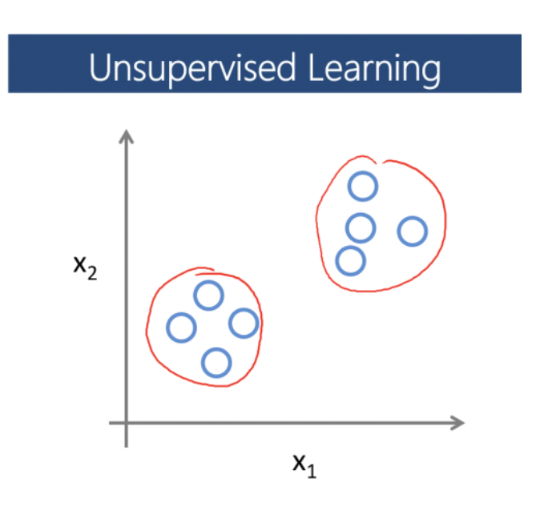
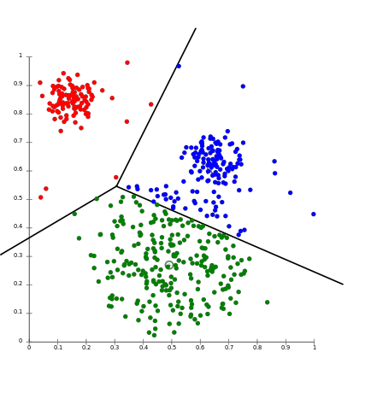
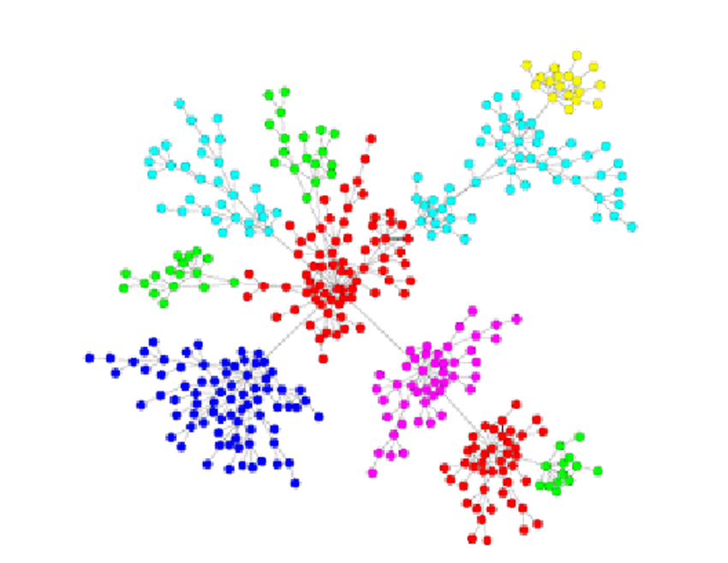
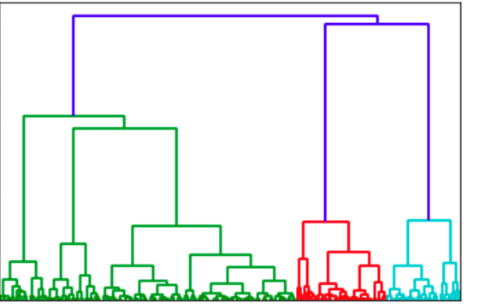
Clustering in reduced dimension space
Clustering requires:
A distance metric
An algorithm to assign elements to groups
For single-cell data:
Graph-based community detection methods
K-means
Hierarchical clustering

Slide 18
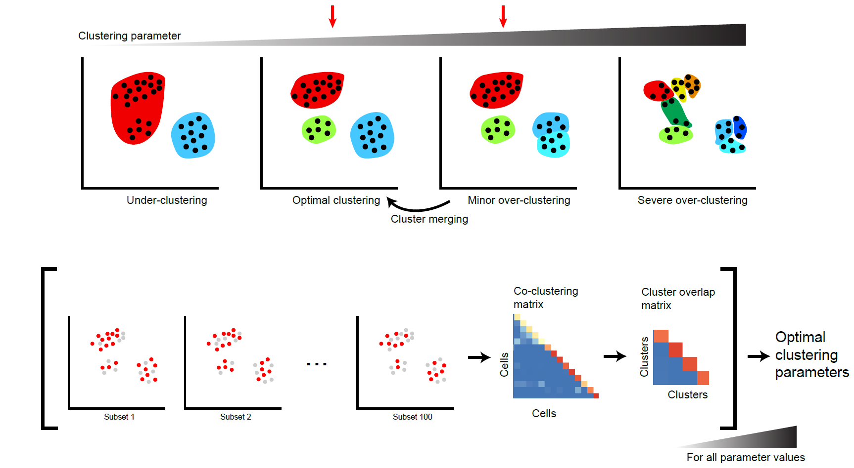
Single-cell RNA-seq clustering is sensitive to parameters
Essential to explore the parameter space!
Patterson-Cross et al. 2021

Slide 19
Standard analytical (clustering) workflow
Select genes to examine (variance-based metrics)
Reduce dimensionality
(PCA, gene clustering, autoencoders, etc.)
Select features on which to cluster
(PCs, gene modules, autoencoder nodes, etc.)
Evaluate cell-cell distances
(PC space, module space, nearest neighbor overlap)
Apply clustering algorithm
(hierarchical, graph-based, mixture models, etc.)

Slide 20
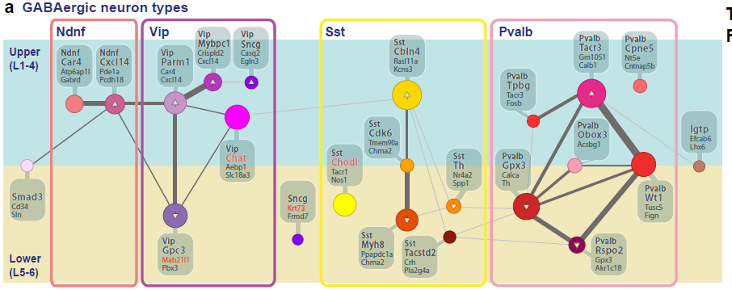
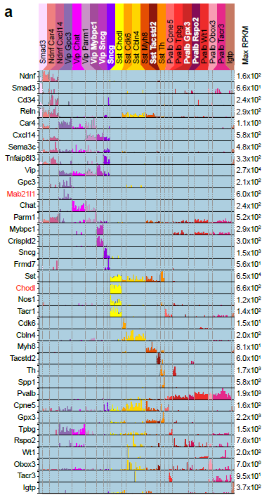
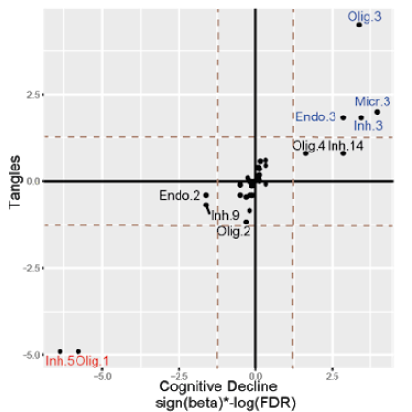
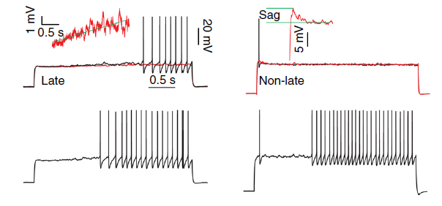
Downstream analysis of putative cell types
Differential gene expression Marker gene selection
Proposed taxonomies
Associations with perturbations or clinical phenotypes
Design of functional validation experiments
Cain et al. 2023
Tasic et al. 2016

